Slide 1
Project Implementation
Ioannis Nakas| External Consultant of the HHF| LB
*The contents of this presentation are sole responsibility of the project beneficiaries and can in no way be taken to reflect the views of the European Union, the participating countries, the Managing Authority and the Joint Secretariat.
The Project is co-financed by the European Regional Development Fund and National Funds of the countries participating in the Cooperation Programme INTERREG VA “Greece-Bulgaria 2014-2020”.

Slide 2
Working Package 1
Project Management:
Project Manager
Financial Manager
Technical Consultant
Controller for verification of expenses
Closing Event – Thessaloniki – 09/11/2023

Slide 3
Working Package 2
Communication Officer
Communication Plan: It describes the project target groups, communication objectives, the communication channels and tools that will be used as well as budget issues.
Closing Event – Thessaloniki – 09/11/2023

Slide 4
Target Groups
Final beneficiaries of the Project’s outputs and results
Local, regional, national authorities and European institutions
NGOs
Scientific and educational institutions
Entrepreneurs
SMEs in Tourism and Hospitality Industry
Graduates in the fields of Accounting and Finance, Business Administration, Hospitality and Tourism and relevant departments
General public (citizens)
Closing Event – Thessaloniki – 09/11/2023

Slide 5
Project Website Structure
https://captour.hhf.gr/
It includes all three languages: English, Bulgarian and Greek
The project website will be kept online at least two years after Project closure
It provides information about the Project, its nature, goals, procedures, benefits and the expected results
Closing Event – Thessaloniki – 09/11/2023

Slide 6
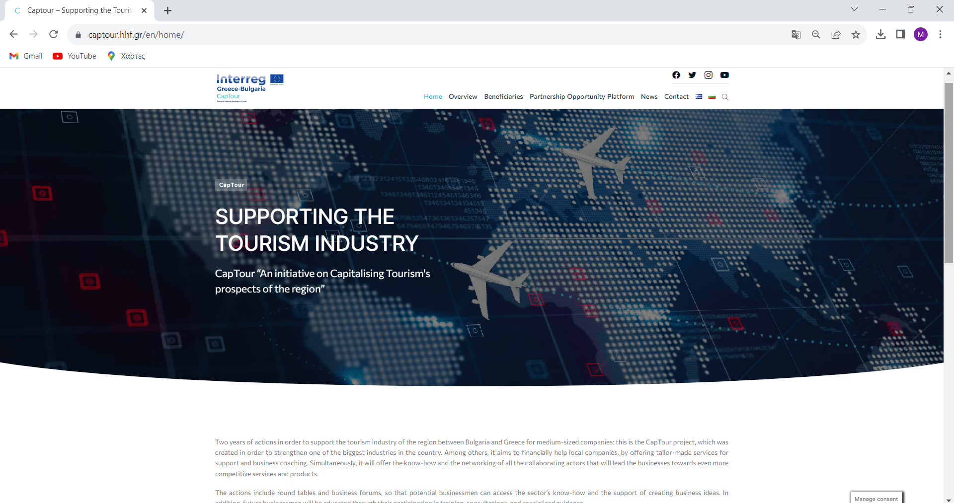

Slide 7
Social Media
Facebook
Twitter
Instagram
YouTube
Closing Event – Thessaloniki – 09/11/2023

Slide 8
Dissemination Material
A Digital Banner was designed in order to link project beneficiaries’ websites
2 Project Leaflets: One at the beginning and one during the final phase of the project
A Poster
A Roll-Up Banner
Folders & Notepads
Closing Event – Thessaloniki – 09/11/2023

Slide 9
Public Events
3 Press Conferences
4 Round Tables in hybrid form
Closing Event
Closing Event – Thessaloniki – 09/11/2023

Slide 10
Working Package 3
Participation in Business Forum in Sandanski organized by PB3
Partnership Opportunities Platform
Closing Event – Thessaloniki – 09/11/2023

Slide 11
Partnership Opportunities Platform
It describes the Project and its aims
It hosts outputs and results (mapping study, round tables, forums & networking-cooperation opportunities)
Trilingual (English, Bulgarian and Greek)
Closing Event – Thessaloniki – 09/11/2023

Slide 12
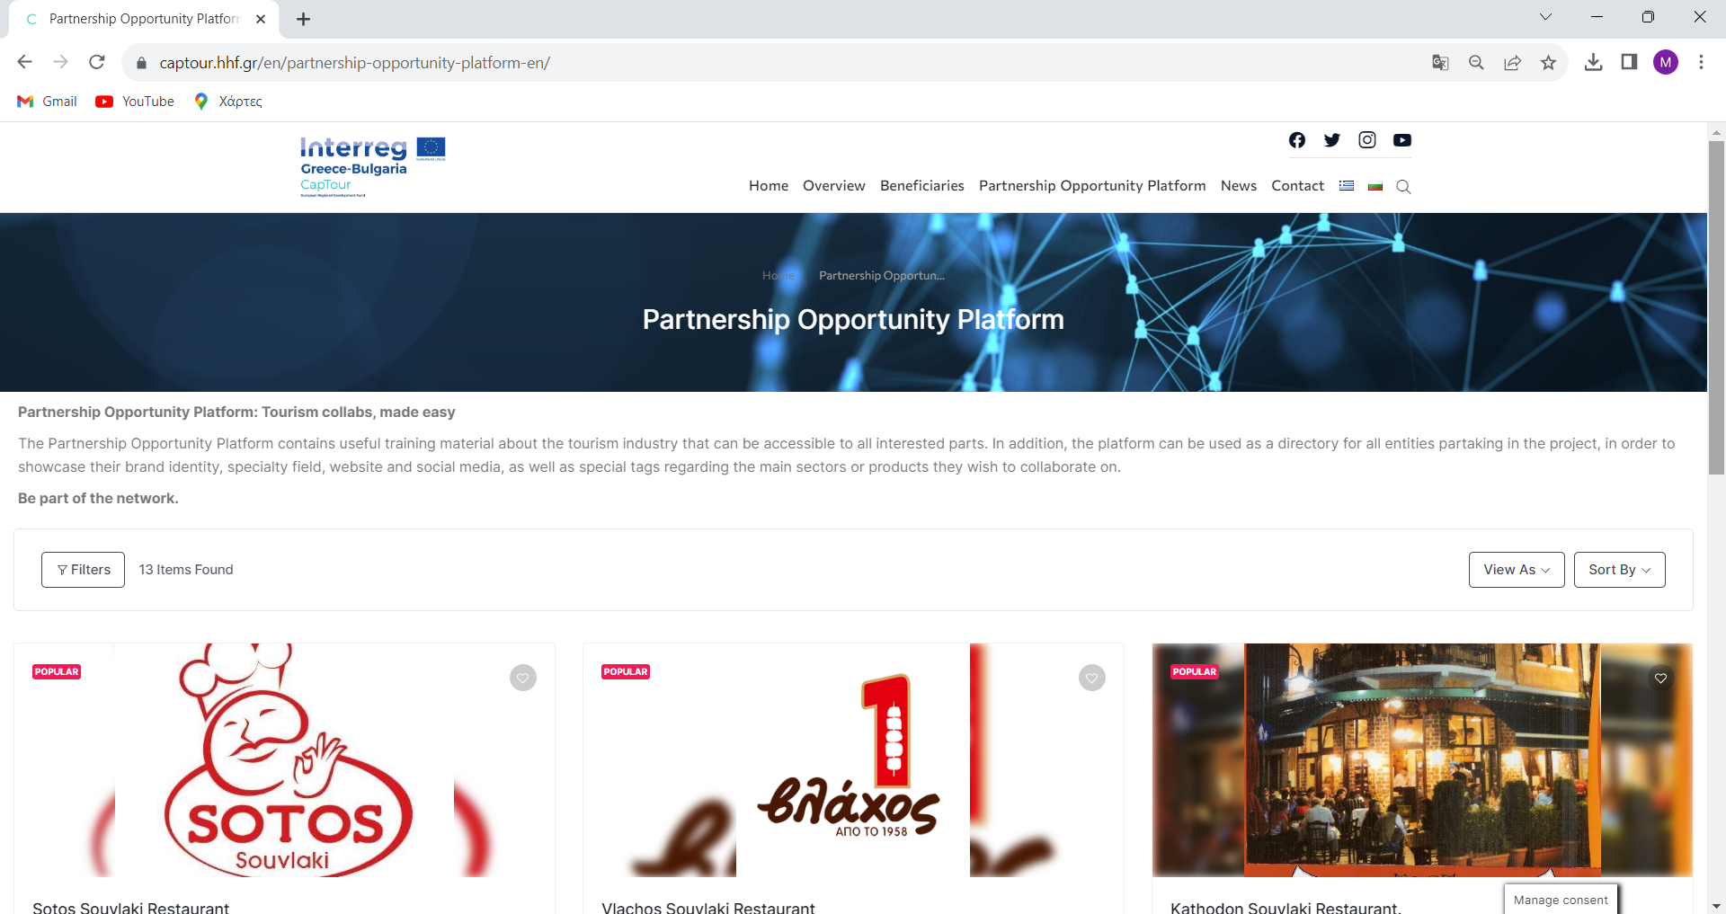
Closing Event – Thessaloniki – 09/11/2023

Slide 13
Working Package 4
Development of training material
Implementation of short building skills' sessions in a hybrid form
Implementation of 2-days workshops in the following topics:
innovation,
Corporate Social Responsibility (CSR),
extroversion,
social economy,
quality standards,
thematic tourism
travel blogging
Closing Event – Thessaloniki – 09/11/2023

Slide 14
Thank you for your kind attention

